Slide 2
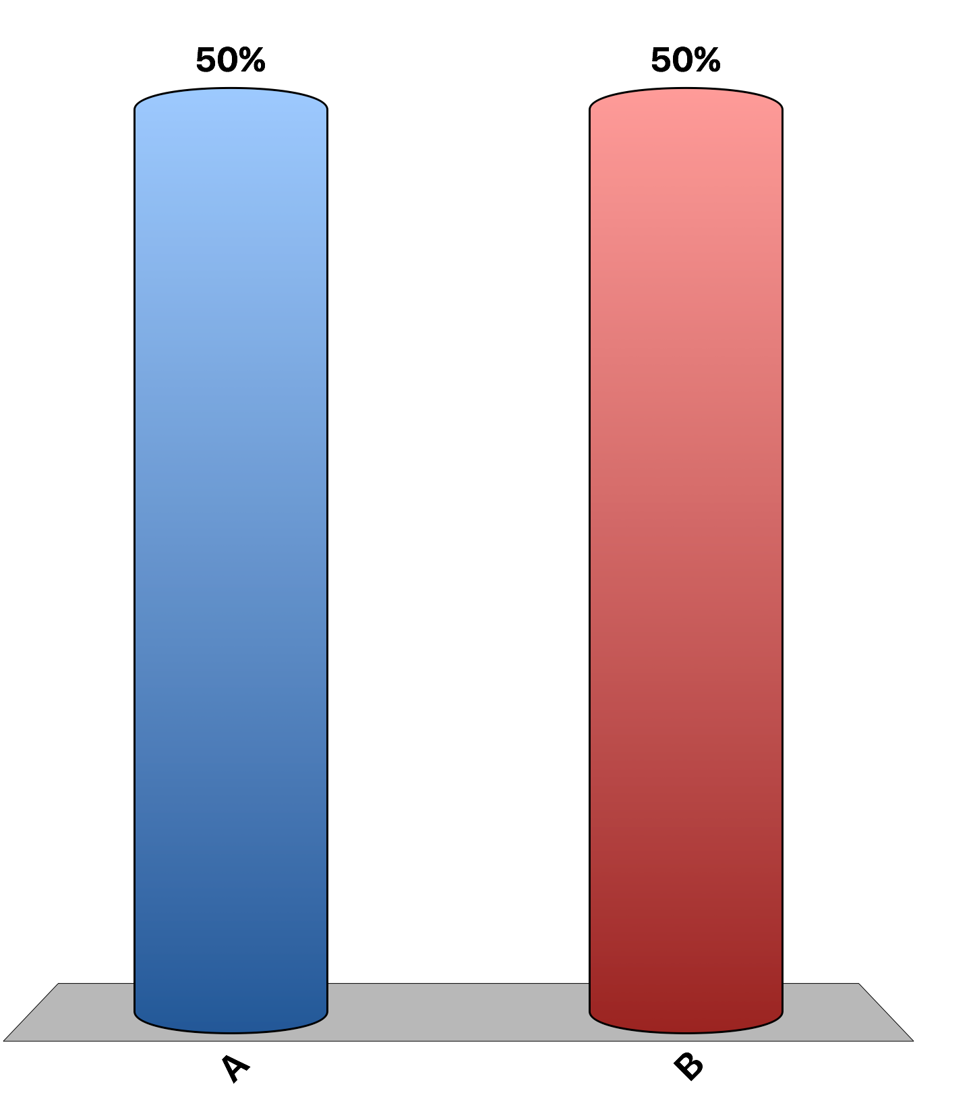
Economics is best defined as the study of how to run a business most profitably.
True
False

Slide 3
Exhaust from a factory that increases health risks for people living near the factory is an example of an externality.
True
False

Slide 4
The business cycle refers to regular and predictable fluctuations in economic activity.
True
False

Slide 5
In 2008 and 2009, the U.S. economy experienced a deep economic downturn. If there is a short-run trade-off between inflation and unemployment, to combat the high unemployment, President Obama should have pursued an inflationary policy such as a stimulus package of reduced taxes and increased government spending.
True
False

Slide 6
A society faces many decisions, but a household does not.
True
False

Slide 7
Public policies aimed at increasing the size of the economic pie also lead to a higher degree of equality.
True
False

Slide 8
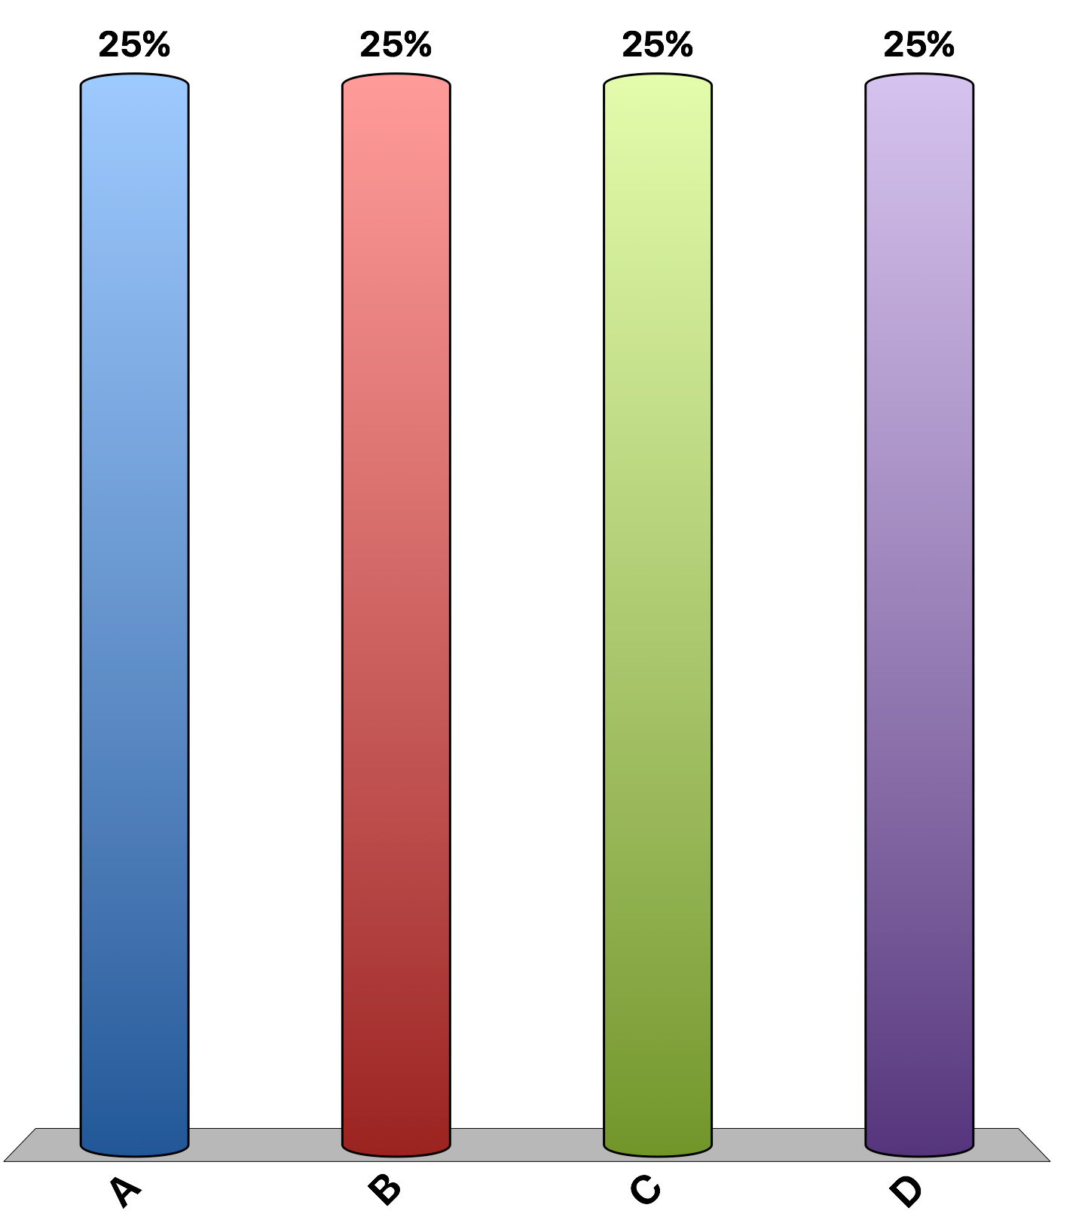
You can stay home and study to do well on your exam or you can go to the movies with your friends, but not both. This example illustrates
scarcity and tradeoffs.
scarcity but not tradeoffs.
tradeoffs but not scarcity.
neither tradeoffs nor scarcity.

Slide 9
Your opportunity cost of going to a Maroon 5 concert during your Spring Break is:
zero, because Maroon 5 is your favorite.
the price of the concert ticket.
the price of the concert ticket plus the cost of any beverages you buy at the concert.
the price of the concert ticket, plus the cost of any beverages you buy at the concert, and the value of your time.

Slide 10
Certain employees are eligible for unemployment compensation if they lose their jobs through no fault of their own. If Jim, a factory worker, will receive compensation of half his regular pay for 52 weeks while he looks for a job, then:
the unemployment compensation most likely raises Jim’s incentive to save while he is working. Unemployment compensation most likely increases Jim’s efforts to find a new job.
the unemployment compensation most likely raises Jim’s incentive to save while he is working. Unemployment compensation most likely decreases Jim’s efforts to find a new job.
the unemployment compensation most likely lowers Jim’s incentive to save while he is working. Unemployment compensation most likely increases Jim’s efforts to find a new job.
the unemployment compensation most likely lowers Jim’s incentive to save while he is working. Unemployment compensation most likely decreases Jim’s efforts to find a new job.

Slide 11
Micah has spent $30 for a taxi ride to attend a Colts game. When he arrives at the stadium, he discovers that he left his ticket at home. He doesn’t have time to return home to get it. He paid $60 for his ticket, but can buy another one for $80. In deciding whether he should buy another ticket Micah should compare the value he places on attending the game to
$30.
$80.
$90.
$170.

Slide 12
Trade between countries tends to
reduce specialization and make everyone better off.
reduce specialization and make everyone worse off.
raise specialization and make everyone better off.
raise specialization but make everyone worse off.

Slide 13
Which of the following is the primary determinant of the standard of living?
labor unions
productivity
the amount of labor
competition from foreign countries

Slide 14
As the manager at the local Save-a-lot, you are thinking of adding one more cashier that would increase sales revenues by $400 per week. What is the most you can pay this new cashier and why?
$200 per week, so the store makes a profit of $200.
$400 per week, because that is the marginal benefit of hiring the new cashier.
$500 per week, because you are fair and pay more than the minimum wage.
I don't have enough information to make this decision.

Slide 15
High inflation is
not associated with high money supply growth rates. An increase in inflation temporarily reduces unemployment.
not associated with high money supply growth rates. An increase in inflation permanently reduces unemployment.
associated with high money supply growth rates. An increase in inflation temporarily reduces unemployment.
associated with high money supply growth rates. An increase in inflation permanently reduces unemployment.

Slide 16
Which of the following is not an incentive effect of higher gasoline prices?
People drive smaller, more fuel-efficient cars.
People take public transportation.
People live closer to where they work.
Exxon-Mobile drills fewer oil wells.

Slide 17
Adam Smith would have loved Uber, the company providing an app for smartphones that connects passengers and drivers, because:
the rides from Uber cars are less expensive than taxis.
Uber cars are more popular than taxis.
the service increases consumer well-being.
the Uber driver do not respond to incentives.

